Slide 1
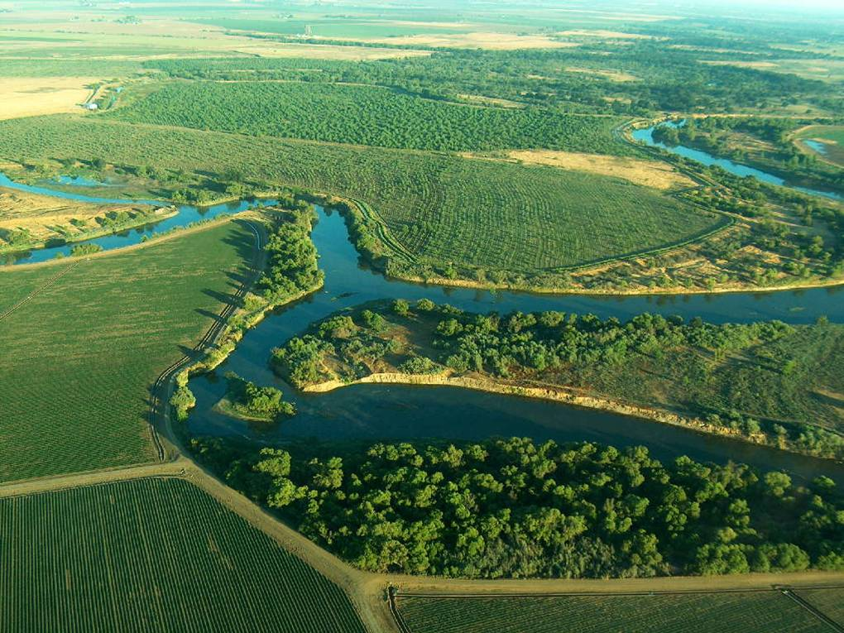
Climate Change Implications for Floodplain Restoration
Gerald Dion
Vice-president
Creating Wildlife Habitat for the Benefit of People and the Environment
Notes:
Title slide

Slide 2
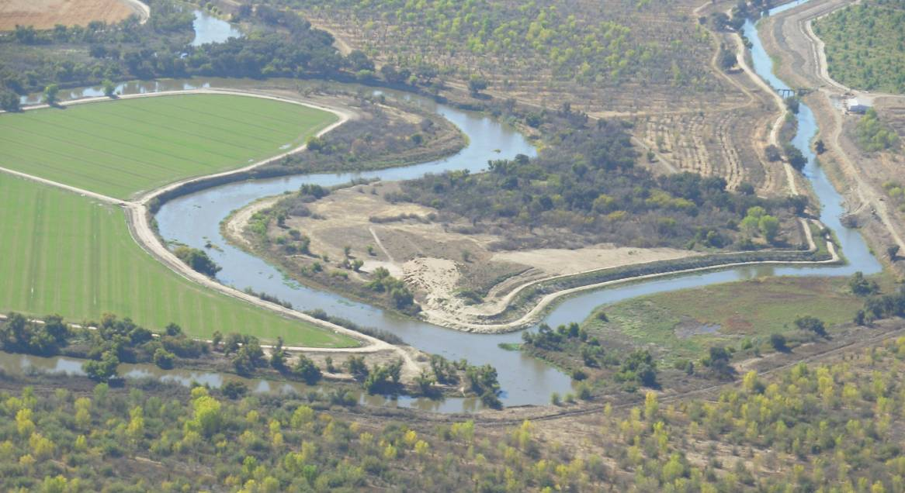
Creating Wildlife Habitat for the Benefit of People and the Environment
Notes:
Our climate is changing and it is going to hurt people in a number of ways:
Coastal sea level rise (like in florida)
Increased incidence of flooding and drought (as less water is stored in the Sierras as snowpack)
Increased regulatory burden (SGMA, water quality, etc.)
Urban issues
Rural issues

Slide 3
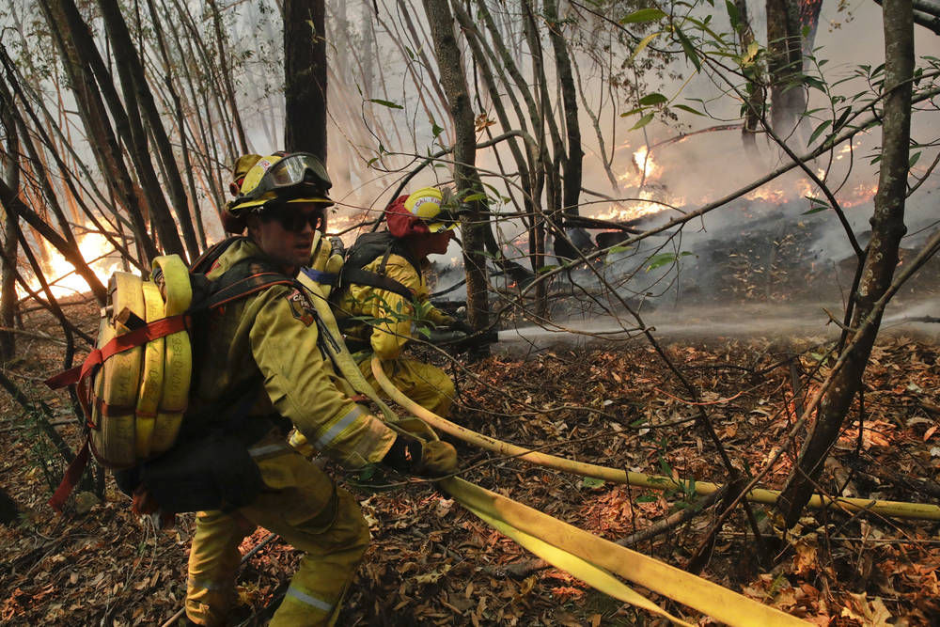
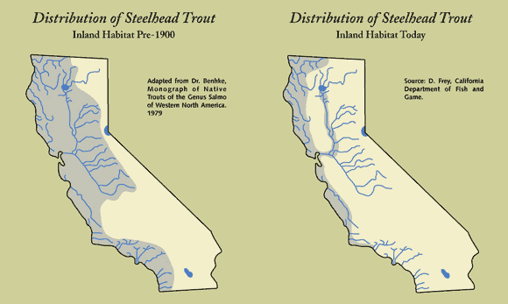
Creating Wildlife Habitat for the Benefit of People and the Environment
Notes:
Climate change is changing habitat values for wildlife too:
Vegetation patterns are changing
Disturbance patterns are shifting
Water is becoming more scarce

Slide 4
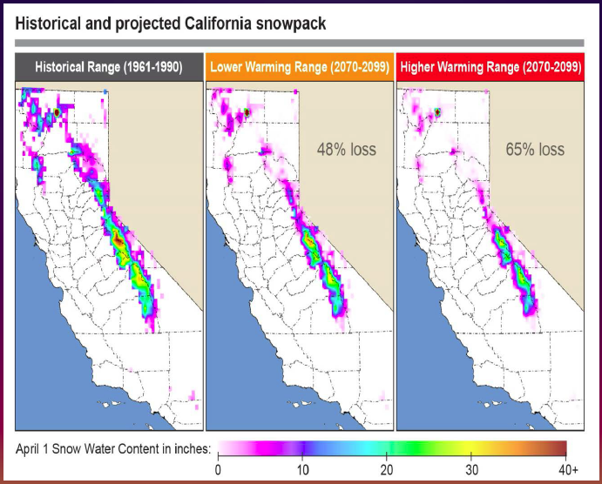
California Climate Commons 2013

Slide 5
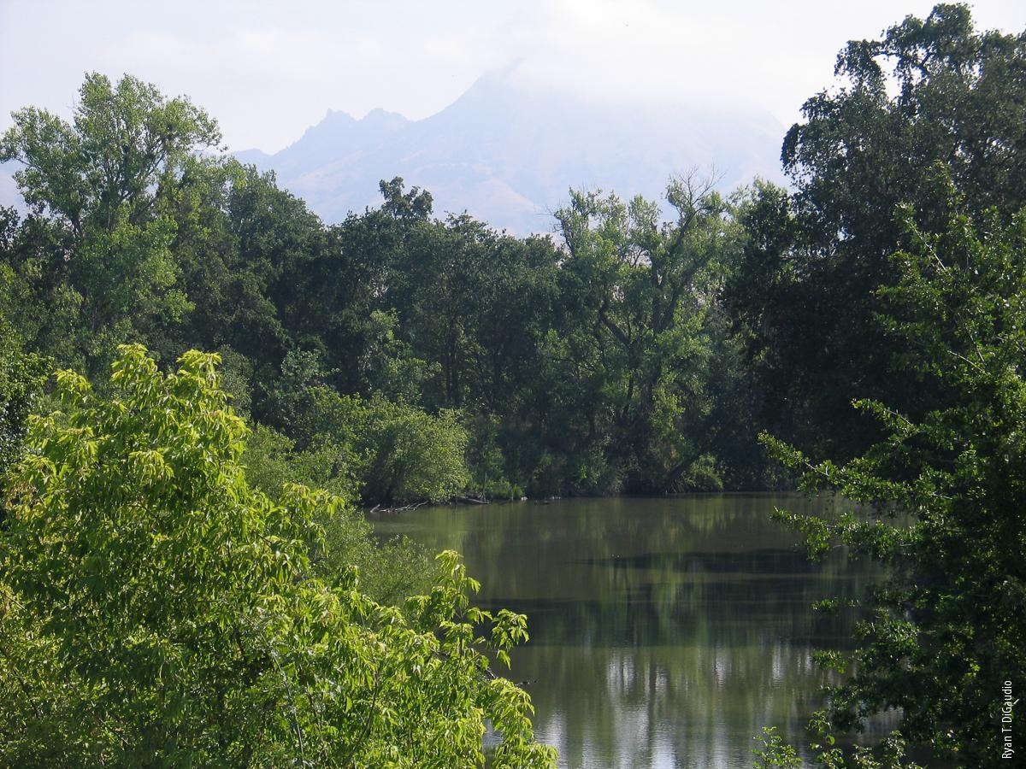

Slide 12
11,000 Acres
~2 Million Trees/Shrubs
8 Miles of Big Rigs

Slide 13
Notes:
2005 60 years

Slide 15
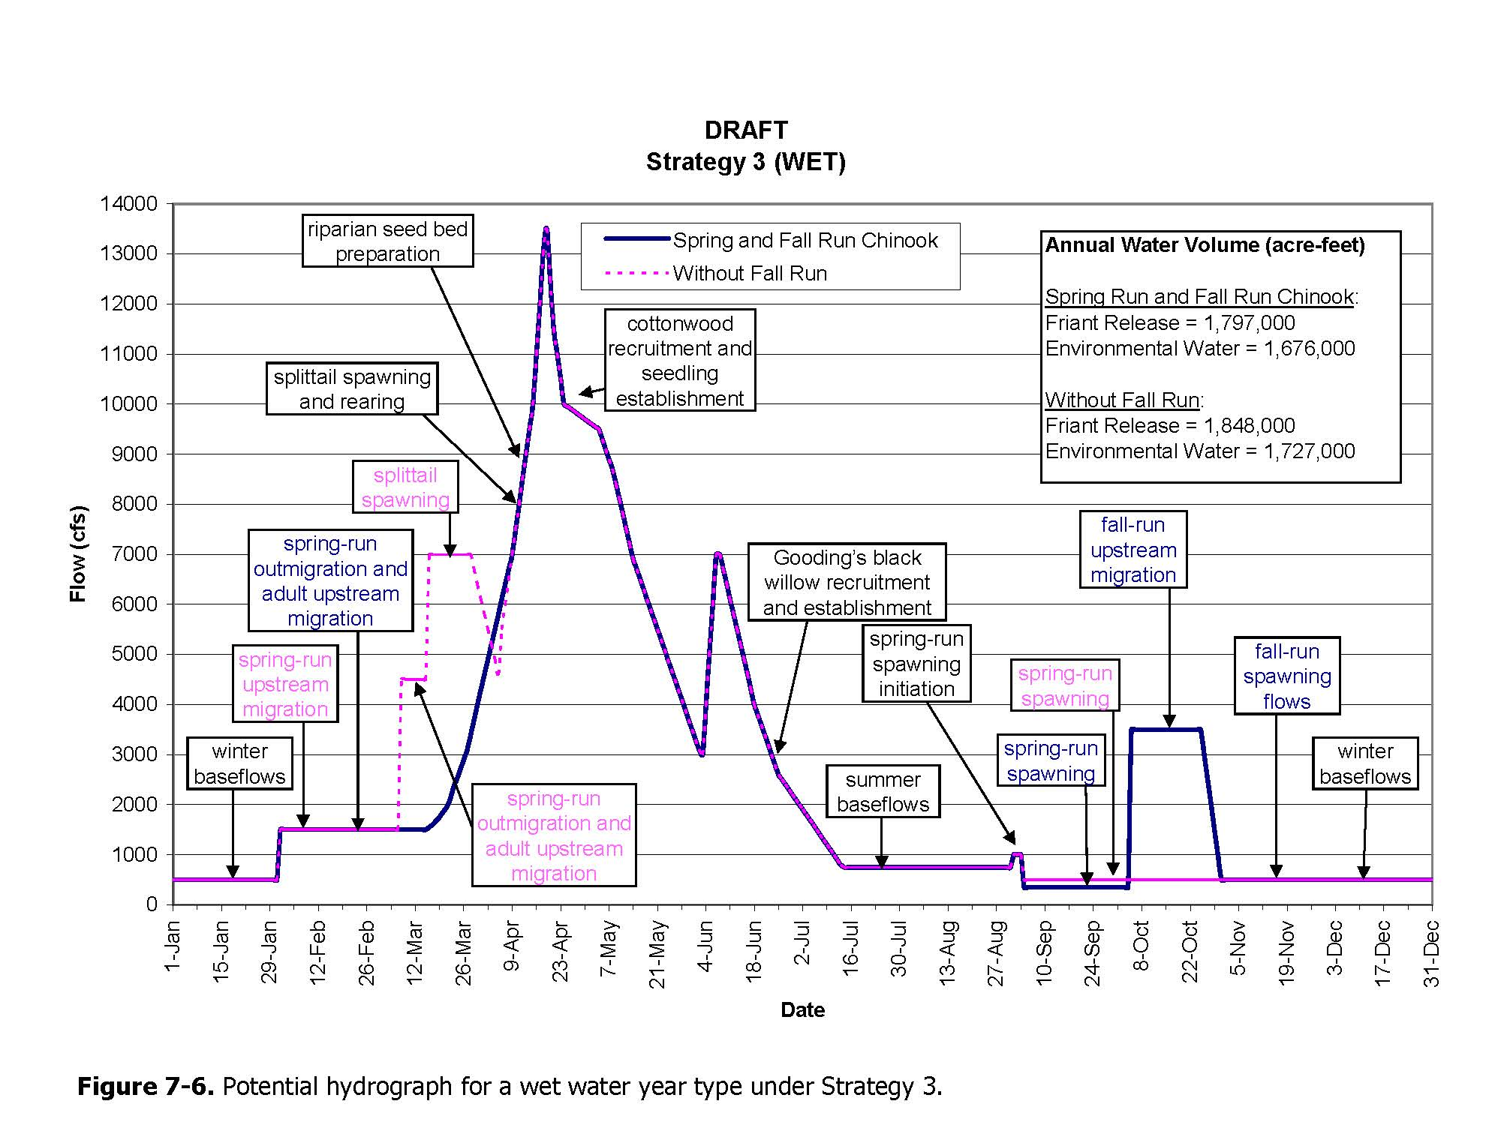
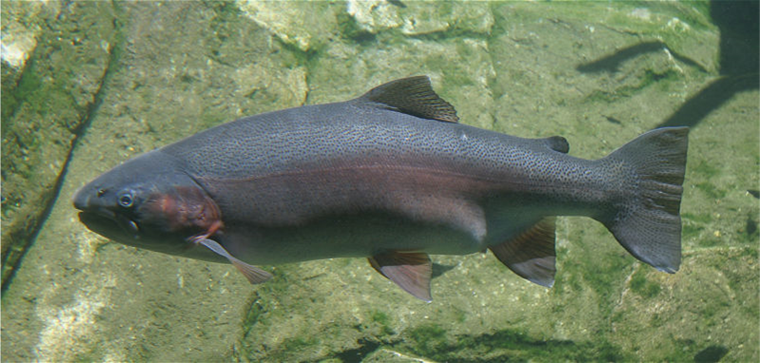
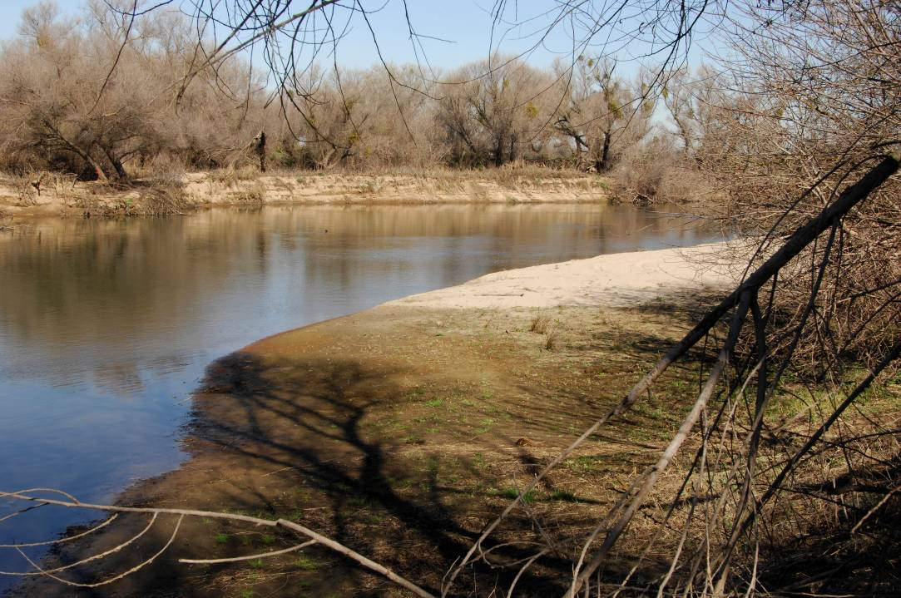
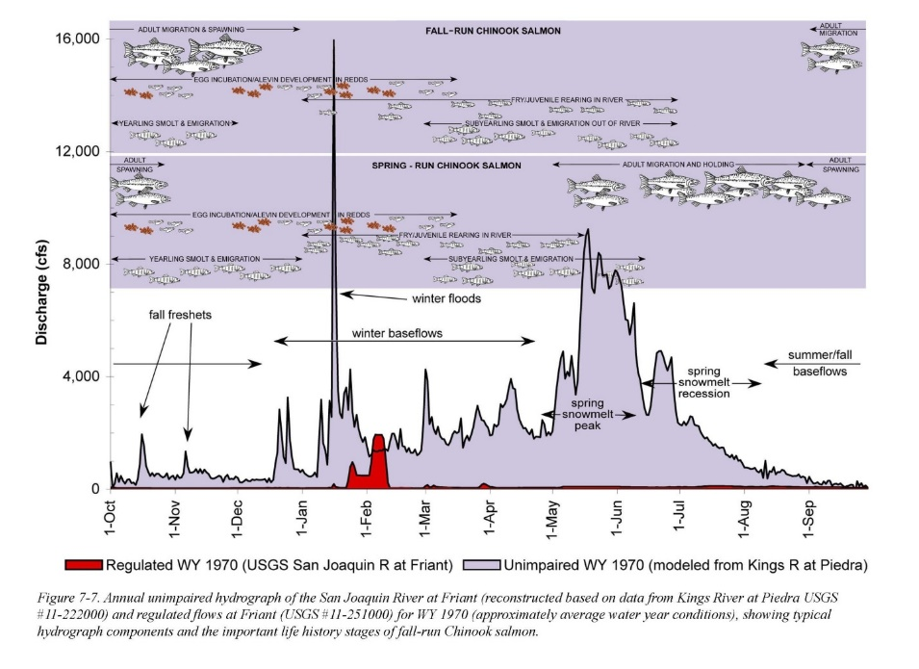
Creating Wildlife Habitat for the Benefit of People and the Environment
Notes:
Wildlife Recovery contributions:
Many species are on the brink of extinction in California
The studies are helpful, but they aren’t going to save wildlife on the brink
We are acting to save them sometimes amidst great uncertainty!

Slide 16
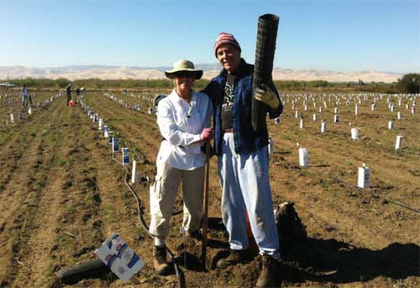
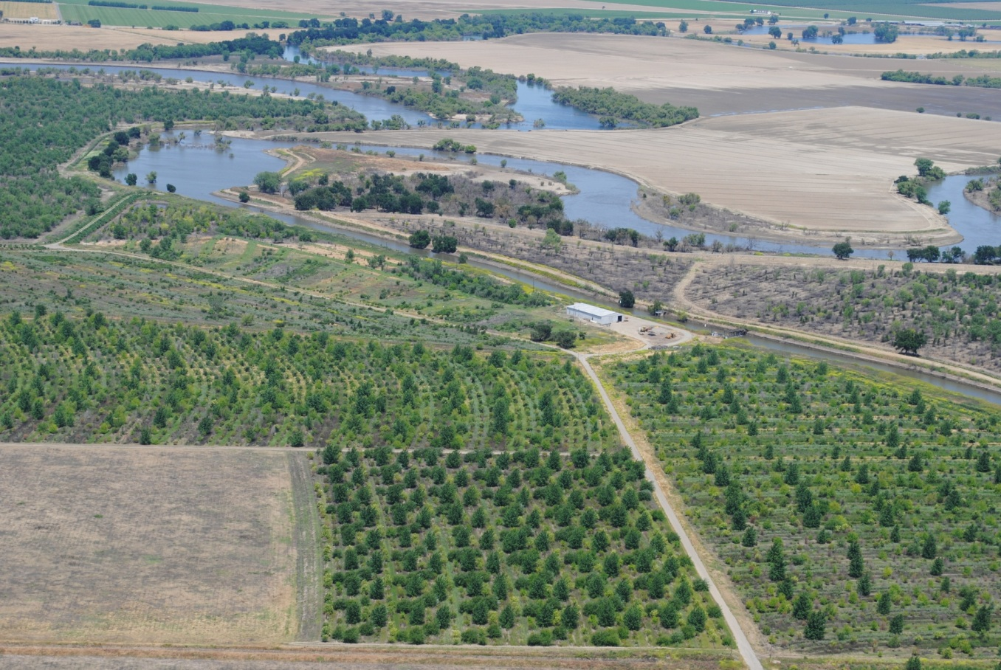
Creating Wildlife Habitat for the Benefit of People and the Environment
Notes:
Wildlife Recovery Contributions:
We use large-scale habitat restoration projects to demonstrate alignment amongst diverse partners working through tough issues
While we represent wildlife primarily, we never lose focus of the people touching our projects in so many ways (irrigators, cities, flood managers, community groups, …)

Slide 17
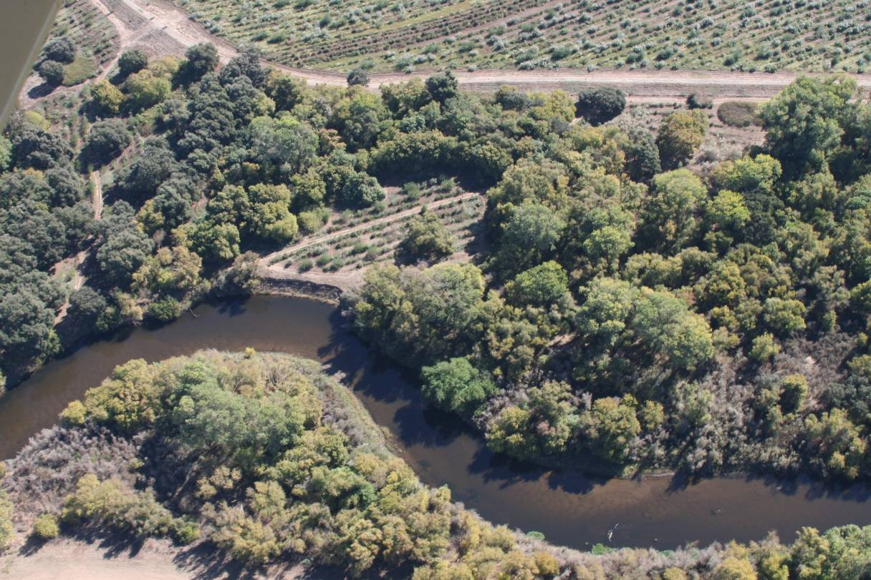
Principle 1: Diversity
Spatial & Genetic
Creating Wildlife Habitat for the Benefit of People and the Environment
Notes:
Principle 1: Diversity
Riparian ecosystems are very diverse. We see vegetation community shifts in response to annual climate fluctuations, we’ll see similar shifts as the climate changes. So, all projects are designed with particular attention to species diversity and genetic diversity within species to create forests that you don’t see in nature, but that function for wildlife in the altered systems of California.

Slide 18
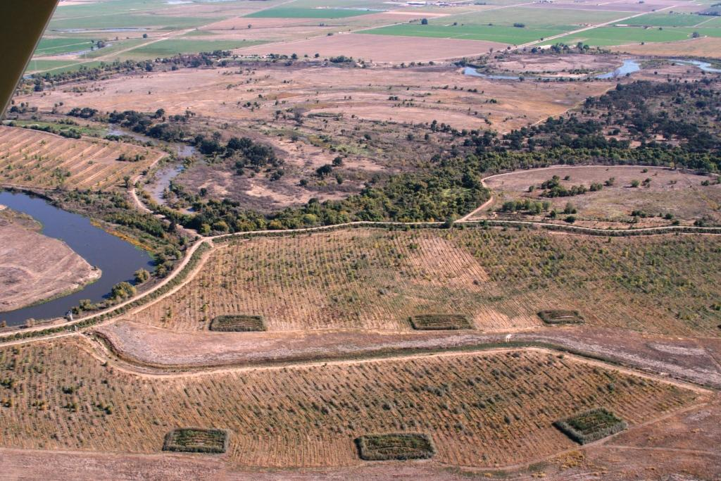
Principle 1: Diversity
Spatial & Genetic
Creating Wildlife Habitat for the Benefit of People and the Environment
Notes:
Principle 1: Diversity
Climate change will create more flashy floods and longer periods of drought. That has implications for river physical processes which support topographic variation across floodplains. The rich suite of wildlife that rely on floodplains need this variation in topography. Ephemeral floodplains support rearing fish without providing habitat for predatory fish. Elevated areas provide refugia for terrestrial wildlife in times of flooding. We create the topographic diversity that once was sustained through river physical processes which have become degraded by human alterations through use of existing man-made structures (like levees) and by constructing new elevated areas (mounds and berms). Water control structures for fish rearing…?

Slide 19
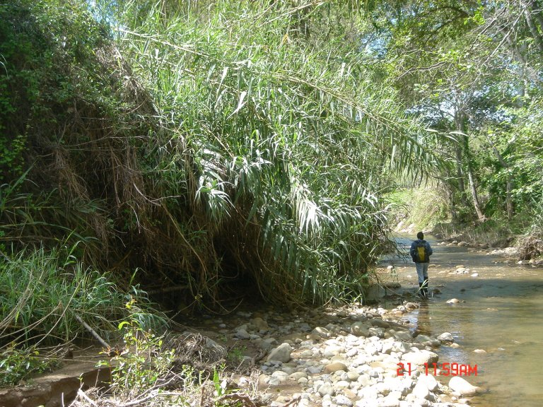
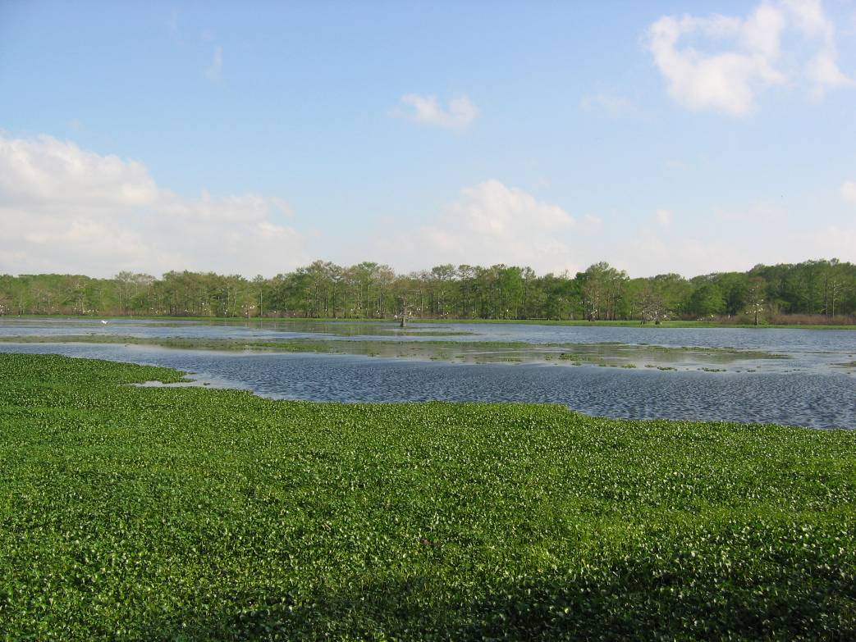
Principle 2: Resilience More Fire & More Weeds
Creating Wildlife Habitat for the Benefit of People and the Environment
Notes:
Principle 2: Resilience (science angle)
With increased incidence of flooding and prolonged drought, disturbances such as fire and weed infestation will increase in frequency. We have 20 years of project experience looking at the habitat response to disturbance. We’ve learned some lessons to plan for resilience:
Use species that readily resprout after fires
Establish dense cover of herbs and grasses that are flood tolerant
Sometimes these species assemblages look like frankenforests… but their design is guided by experience and research

Slide 20
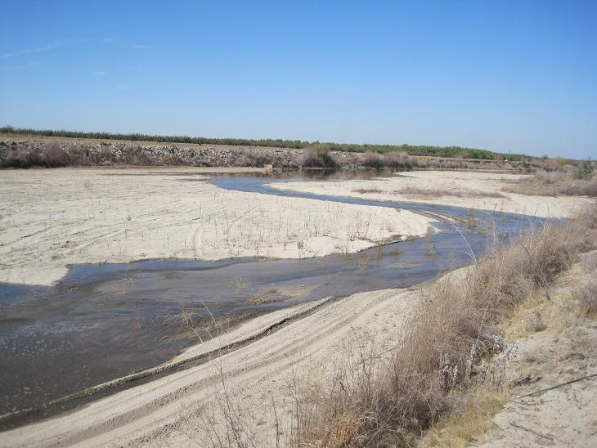
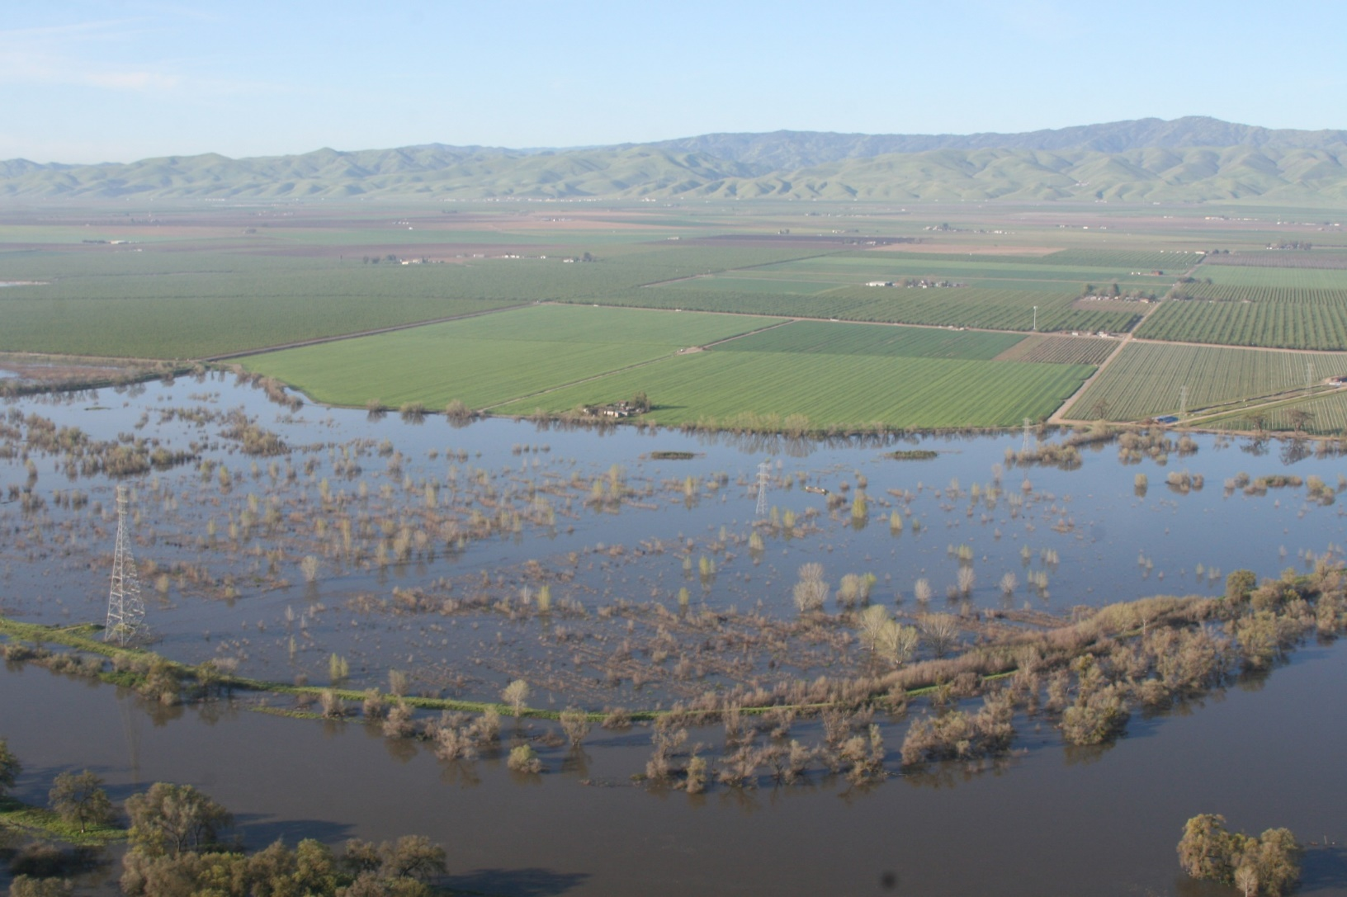
Principle 2: Resilience Organizational & Adaptive
Creating Wildlife Habitat for the Benefit of People and the Environment
Notes:
Principle 2: Resilience (organizational angle)
We are in it for the long haul – our adaptive management framework has us constantly learning and improving with each new project.
Institutionally, California is learning by doing at 30,000’. Using our adaptive management framework as it applies to organizations, we are building lasting partnerships that can build shared understanding and weather the ups and downs of organizational dynamics as the regulatory environment changes.

Slide 21
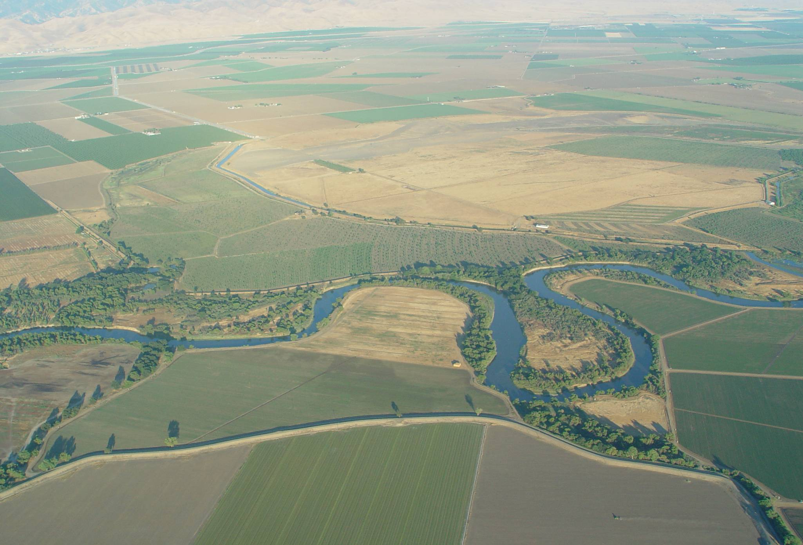
Principle 3: Corridor thinking:
Creating Wildlife Habitat for the Benefit of People and the Environment
Notes:
Corridor thinking:
Our river corridors will be the migration pathways for wildlife seeking thermal refuge during longer periods of warmer temperatures.
We conceive of projects at the 30,000’ view, and work to make them happen on the ground. By working across scales, we are able to see the corridor for all its uses and its connectivity across the landscape.

Slide 22
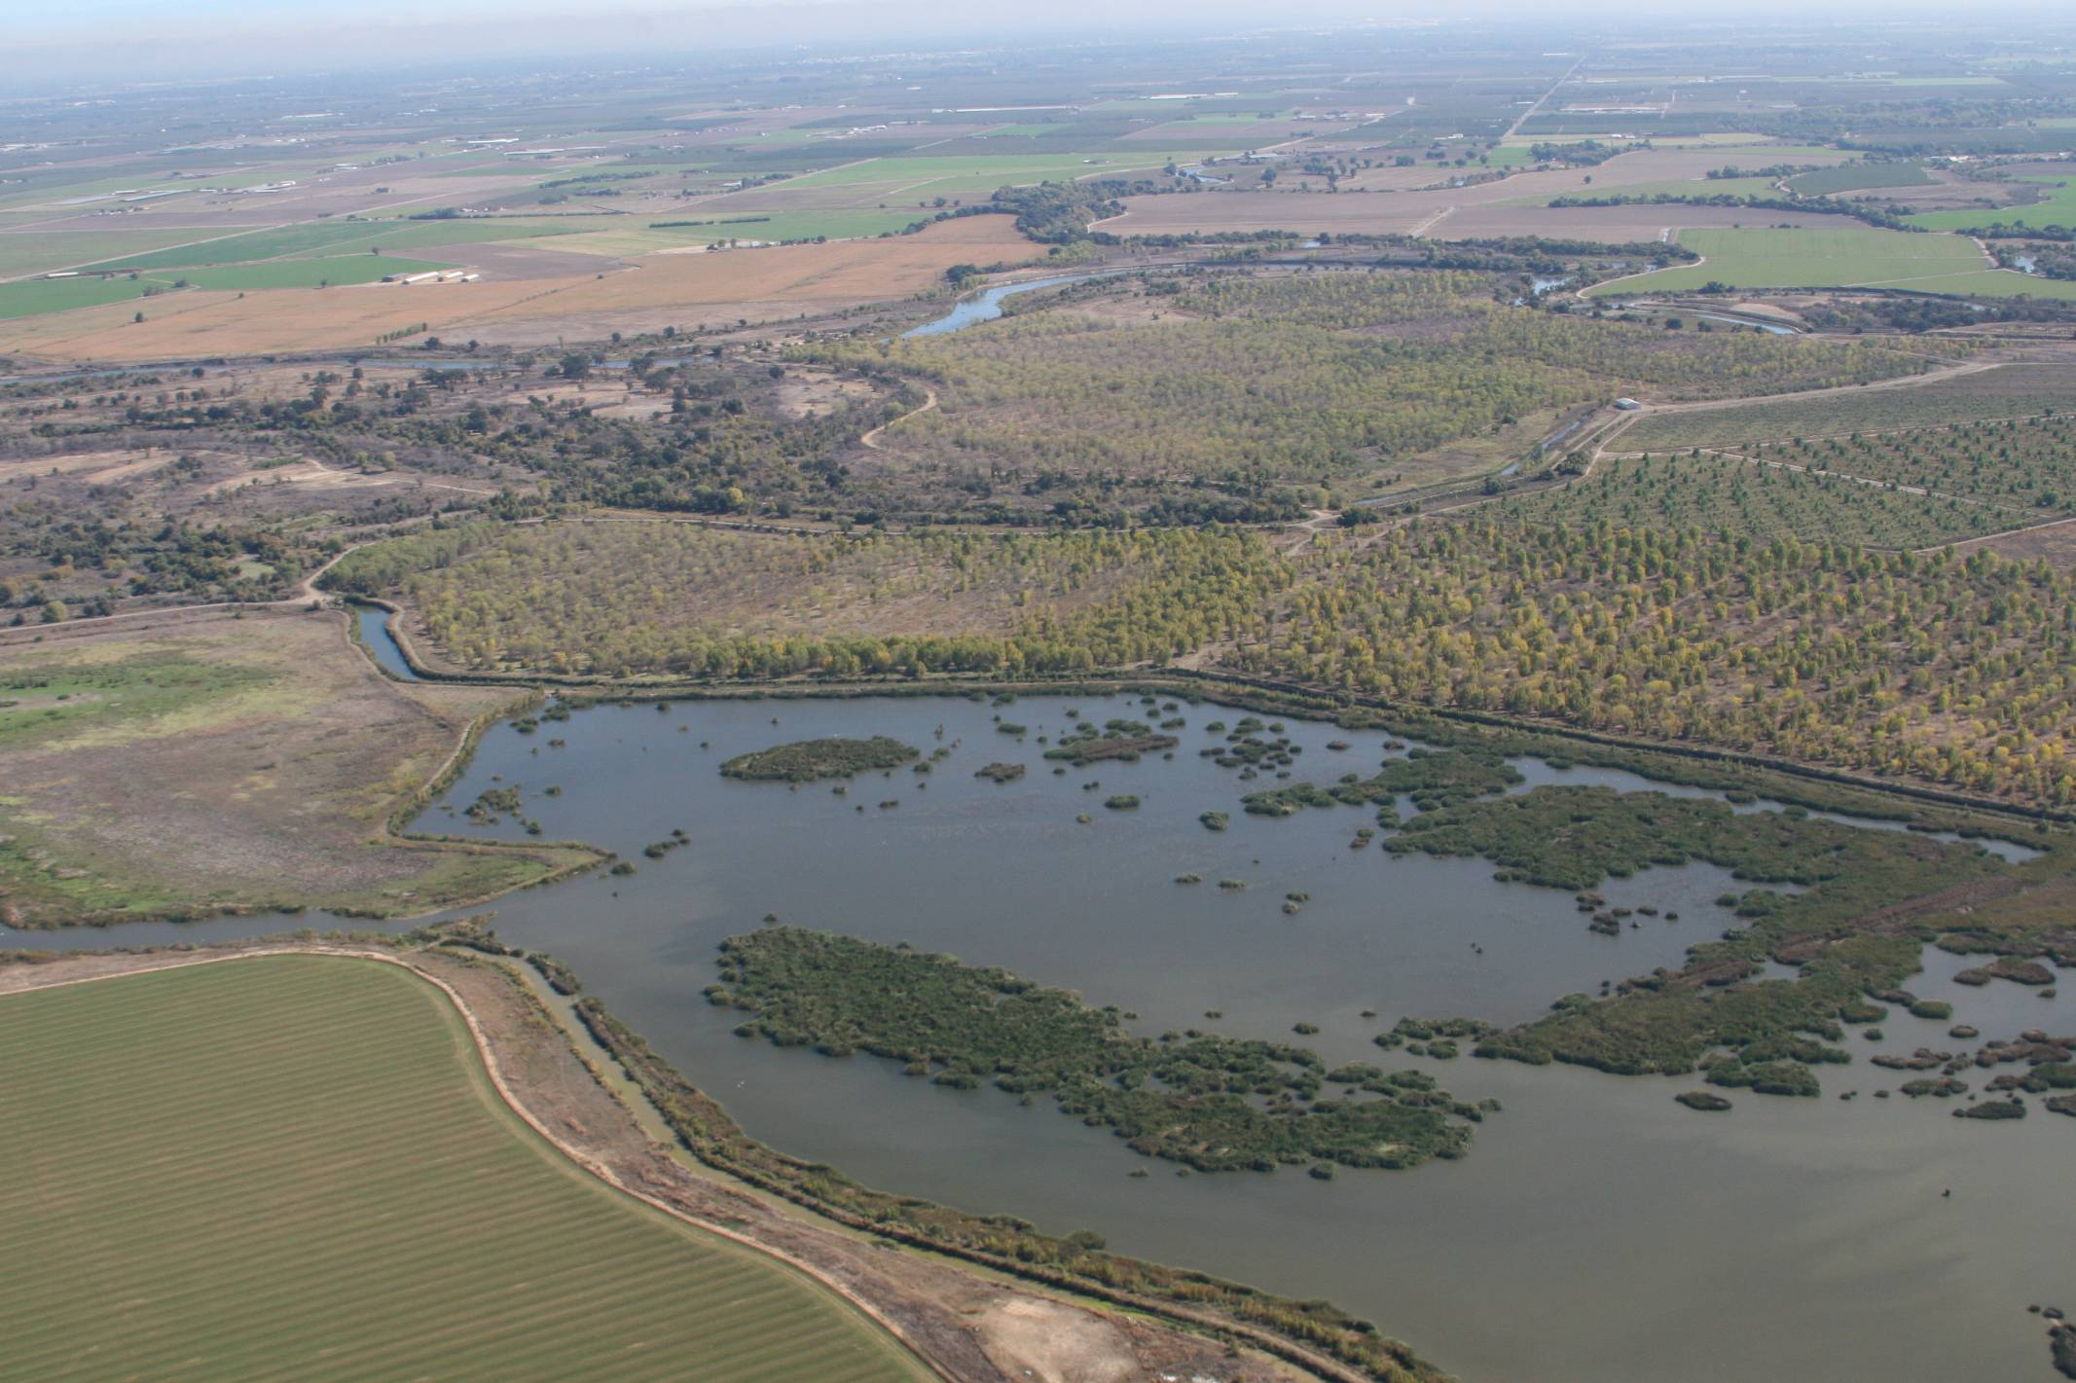
Principle 4: Value Everything Water
Creating Wildlife Habitat for the Benefit of People and the Environment
Notes:
Accurately valuing water
Although the institutional structures are not in place yet, we think about projects as they contribute to the entire water budget in California. Retiring agricultural irrigation on one thousand acres might yield the same water savings as raising a dam by one foot.
WSIP story
If WE can accurately value water, then We will see improvements to our economy and its resilience to climate change

Slide 23
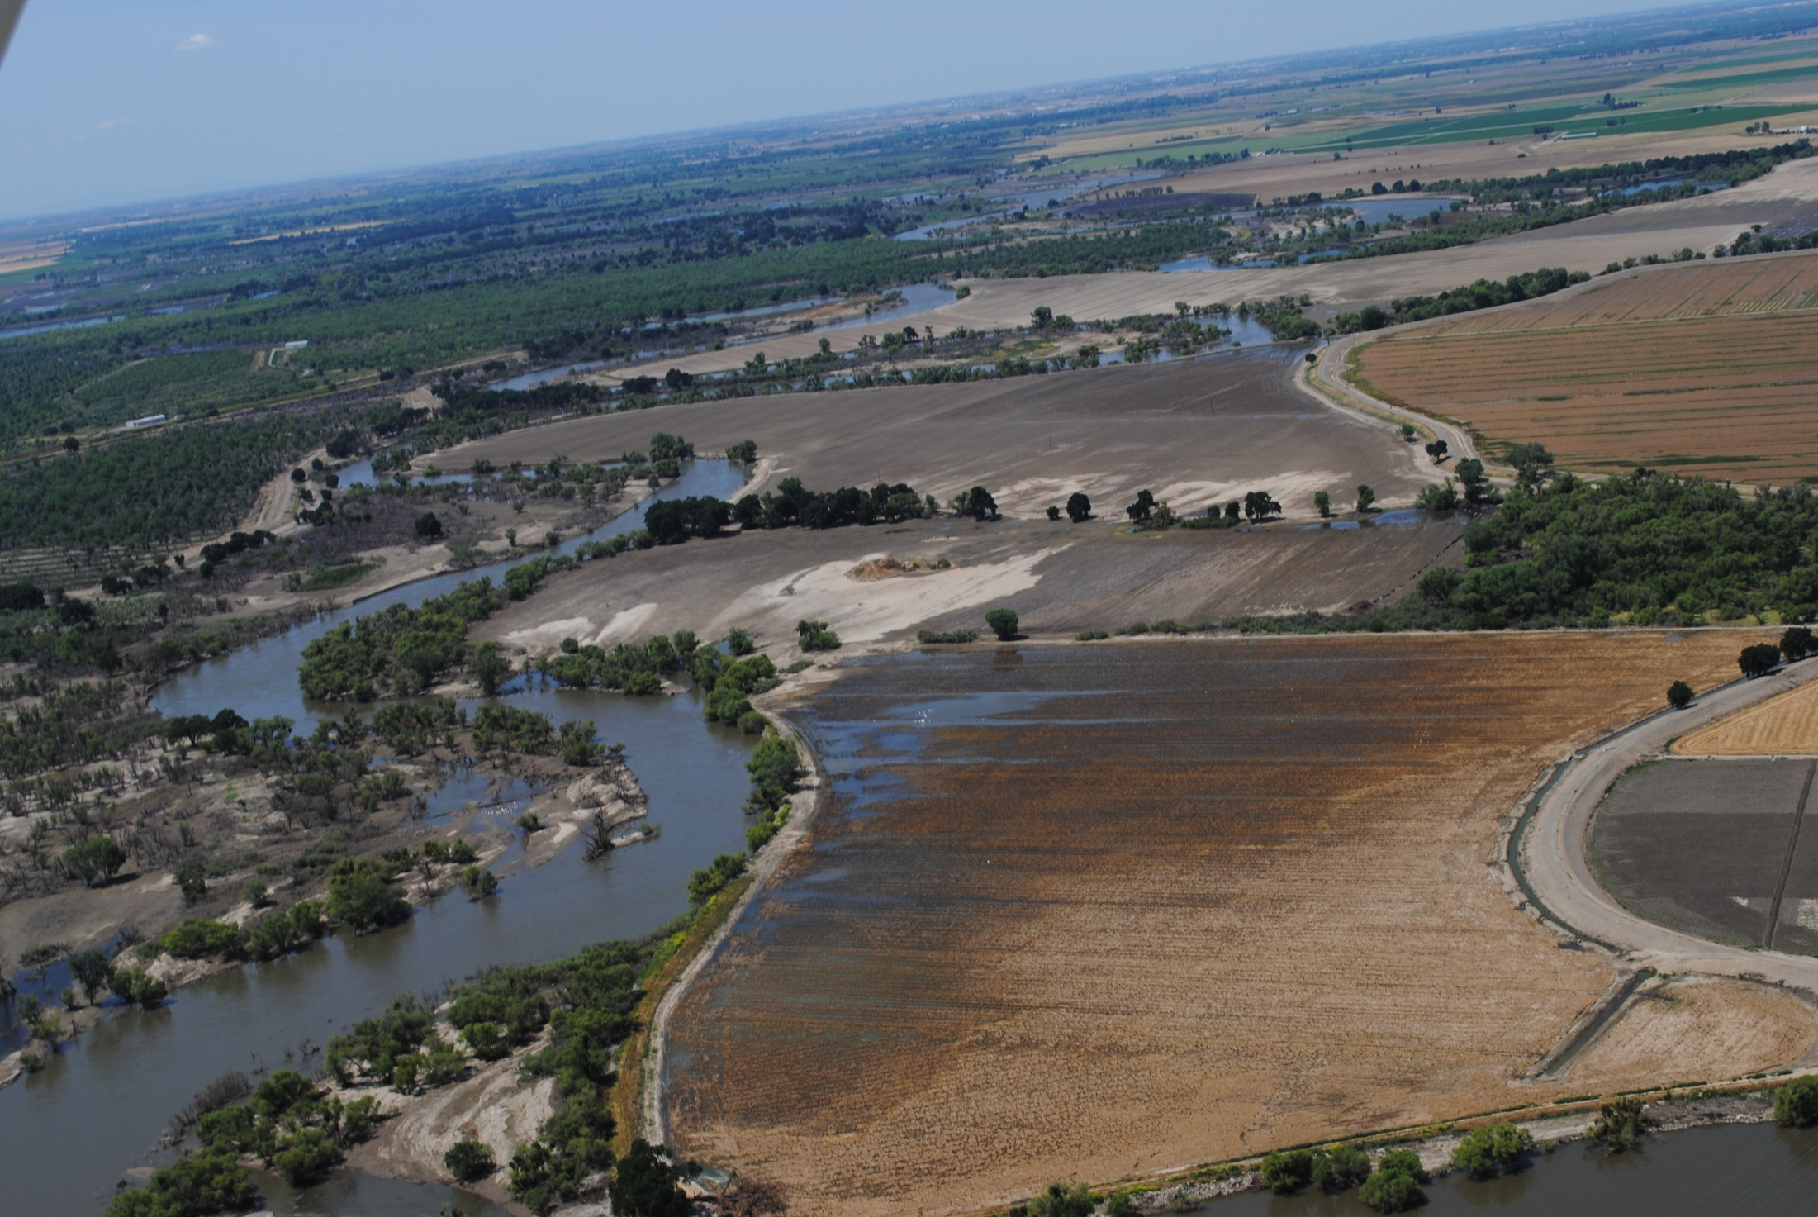
Principle 4: Value Everything Carbon
Our Project Carbon:
11,000 Acres at roughly 181 tons of Carbon/ac
is roughly 2 million tons
That is roughly 42,000 cars for 10 years each
which is 80 miles of cars
Creating Wildlife Habitat for the Benefit of People and the Environment
Notes:
Accurately valuing carbon
Forested floodplains are carbon sinks, especially as compared to tilled agriculture – at a large scale, our work can make a significant contribution to carbon mitigation
We are looking to partner with University researchers to develop accounting methods for our riparian forests Roughly 2 million tons That is the equicant of ten years worth of driving for 42,000 cars. Six smallest countys

Slide 24
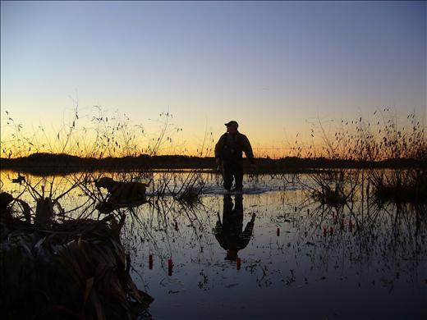
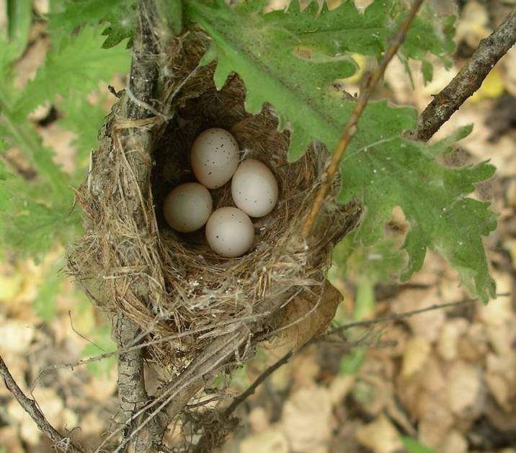
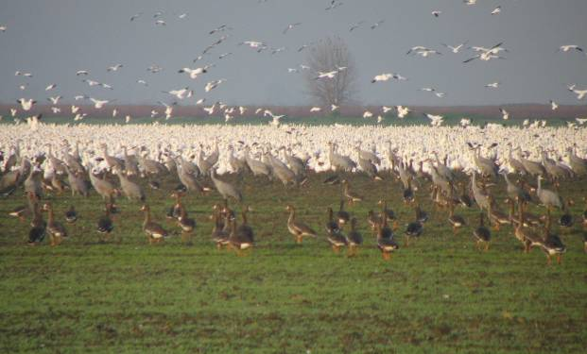
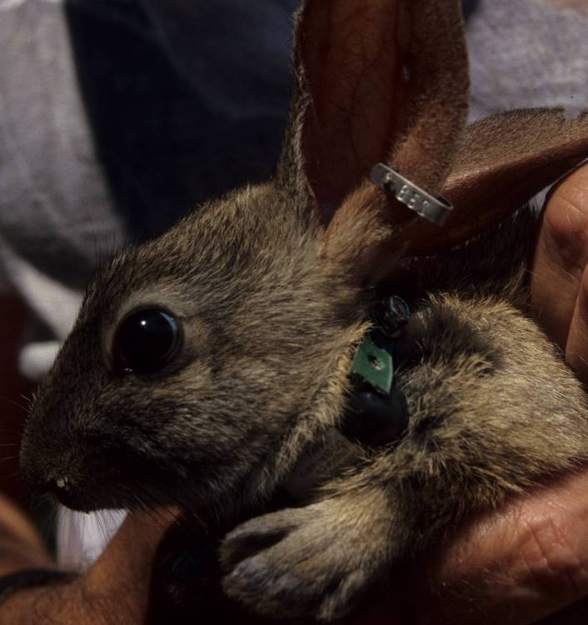
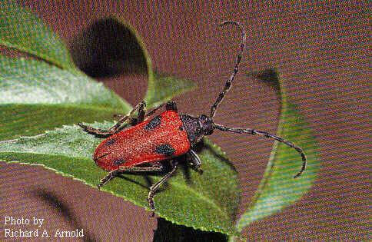
Creating Wildlife Habitat for the Benefit of People and the Environment
Notes:
Storing carbon in a multi-benefit project yields several layers of conservation outcomes

Slide 25
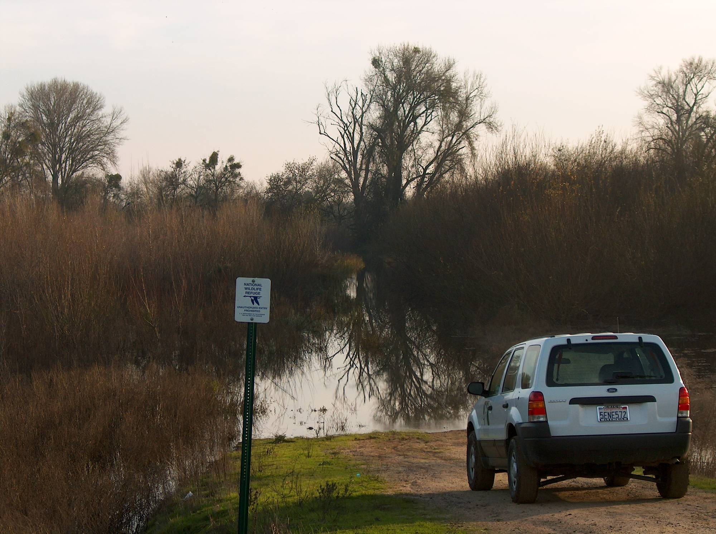
Creating Wildlife Habitat for the Benefit of People and the Environment
Notes:
Questions?

